Slide 1
GRAM SCHMIDT PROCESS

Slide 2
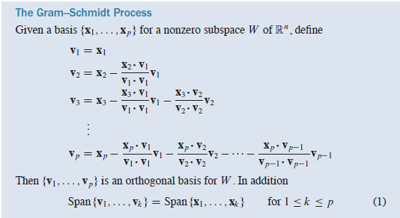
GRAM SCHMIDT PROCESS
Orthonormal Bases

Slide 3
QR Factorization
If an m*n matrix A has linearly independent columns x1; : : : ; xn, then applying the Gram–Schmidt process (with normalizations) to x1; : : : ; xn amounts to factoring A,

Slide 4
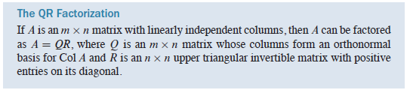
QR Factorization

Slide 5
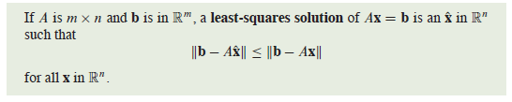
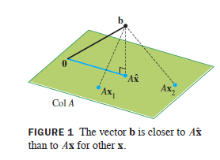
Least-Squares Problem
we seek an x that makes Ax the closest point in Col A to b.
if b happens to be in ColA, then b is Ax for some x, and such an x is a “least-squares solution

Slide 6

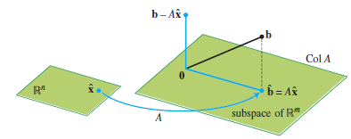


Solution of the General Least-Squares Problem
normal equations

Slide 7

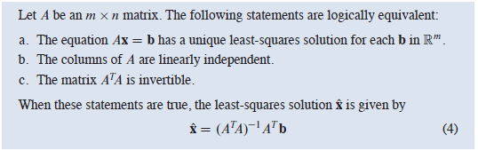
Least-Squares Problem
Least Square Solution is unique?

Slide 8
APPLICATIONS TO LINEAR MODELS

Slide 9
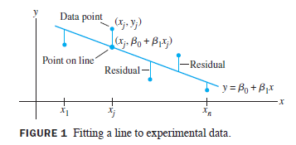
Least Square line
A common task in science and engineering is to analyze and understand relationships among several quantities that vary
data are used to build or verify a formula that predicts the value of one variable as a function of other variables
Least-Squares Lines
Goal: determine the parameters B0 and B1 that make the line as “close” to the points as possible

Slide 10
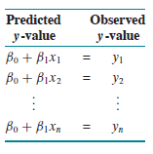
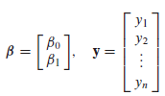

Least Square line
There are several ways to measure how “close” the line is to the data.
Usual choice is to add the squares of the residuals
least-squares line is the line that minimizes the sum of the squares of the residuals
line of regression of y on x
Linear regression coefficients

Slide 11
Least Square line
Computing the least-squares solution of XB=y is equivalent to finding the B that determines the least-squares line in Figure 1
goal is to minimize the length of residual (error), which amounts to finding a least-squares solution

Slide 12
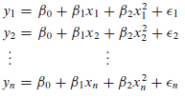
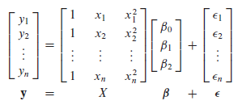
example

Slide 13
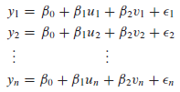
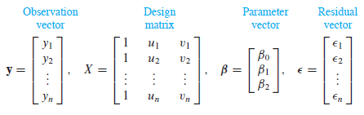
Multiple Regression

Slide 14
Symmetric Matrices and Quadratic Forms

Slide 15

DIAGONALIZATION OF SYMMETRIC MATRICES

Slide 16

DIAGONALIZATION OF SYMMETRIC MATRICES
An n* n matrix A is said to be orthogonally diagonalizable if there are an orthogonal matrix P and a diagonal matrix D such that
Such a diagonalization requires n linearly independent and orthonormal eigenvectors.
When is this possible?

Slide 17
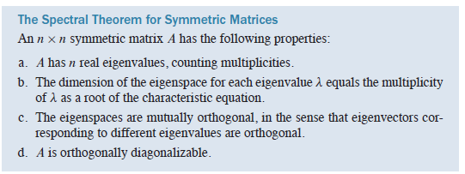

Slide 18
Spectral Decomposition
spectral decomposition of A

Slide 19
Quadratic form

Slide 20
Quadratic form
Change of Variable in a Quadratic Form

Slide 21
Quadratic form

Slide 22
Classifying Quadratic Forms

Slide 23
Proof
positive definite matrix A is a symmetric matrix for which the quadratic form
xTAx is positive definite

Slide 24
CONSTRAINED OPTIMIZATION

Slide 25
CONSTRAINED OPTIMIZATION
Engineers, economists, scientists, and mathematicians often need to find the maximum or minimum value of a quadratic form Q(x) for x in some specified set.

Slide 26
example

Slide 27
CONSTRAINED OPTIMIZATION

Slide 28
CONSTRAINED OPTIMIZATION

Slide 29
CONSTRAINED OPTIMIZATION

Slide 30
singular value decomposition

Slide 31


Introduction
The absolute values of the eigenvalues of a symmetric matrix A measure the amounts that A stretches or shrinks certain vectors (the eigenvectors)
Example

Slide 32


example

Slide 33


Singular Values

Slide 34
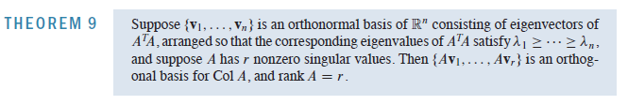

Theorem
Col A

Slide 35
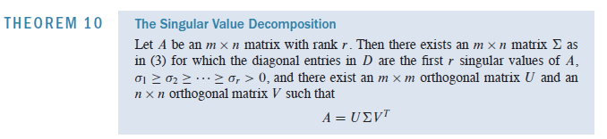

SVD
matrices U and V are not uniquely determined by A, but the diagonal entries of D
are necessarily the singular values of A
columns of U left singular vectors of A
columns of V right singular vectors of A

Slide 36



proof

Slide 37
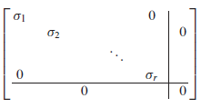

proof

Slide 38







example

Slide 39







example

Slide 40


example
Gram-Schmidt

Slide 41




SVD for Image Compression
Redundancy exists in Images
Size of images
Compression

Slide 42

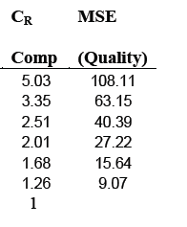
SVD for Image Compression
To measure the quality between original image A and the compressed image Ak, the
measurement of Mean Square Error (MSE)

Slide 43




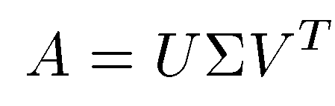
Face Recognition: PCA (principle component analysis)
SVD approach treats a set of known faces as vectors in a subspace, called “face space”
Assume each face image has m × n = M pixels
an M × 1 column vector fi
A training set, S with N number of face images of known individuals forms an M × N matrix:

Slide 44



Face Recognition: PCA
Minimize the distance

Slide 45
